Slide 1
Tamworth Regional Council
Community Research
Prepared by: Micromex Research
Date: February 2022

Slide 2
Table of Contents
Summary and Next Steps | 5
Detailed Results | 8
1. Living in Tamworth | 9
2. Key Performance Indicators | 13
3. Communication | 29
4. Community Strategic Plan | 32
5. Future Needs Development | 43
6. Service Area Analysis | 47
Appendix A: Additional Analyses | 58
Appendix B: Detailed Background & Methodology | 70
Appendix C: Questionnaire | 74

Slide 3
Background & Methodology
Objectives (Why?)
Assessing and establishing the community’s priorities and satisfaction in relation to Council activities, services, and facilities
Identifying the community’s overall level of satisfaction with Council’s performance
Identifying methods of communication and engagement with Council
Identifying top priority areas for Council to focus on
Identifying community levels of importance for key directions for the CSP
Sample (How?)
Telephone survey (landline and mobile) to N = 600 residents
We use a 5 point scale (e.g. 1 = not at all satisfied, 5 = very satisfied)
Greatest margin of error +/- 4.0%
Timing (When?)
Implementation 16th December 2021 – 11th January 2022

Slide 4
The sample was weighted by age and gender to reflect the 2016 ABS community profile of Tamworth Regional Council.
Sample Profile
Gender
Age
Household type
Female 52%
Male 48%
Single/living alone 13%
Single parent (children at home) 6%
Country of birth
Employment status | N=600
Work in the Tamworth LGA | 59%
Retired | 22%
Work outside the Tamworth LGA | 7%
Unemployed/pensioner | 5%
Home duties | 1%
Student | 1%
Other | 3%
Couple
(children at home)
50%
Couple
(no children at home) 19%
Overseas 4%
Australia 96%
Ratepayer status
Living at home with one or more parents 7%
Group/extended family/other
Household 5%
Time lived in the area
Ratepayer
81%
Non-ratepayer 19%
Base: N = 600

Slide 5
Summary and Next Steps

Slide 6
Summary Findings
Of residents rate their quality of life as good, very good or excellent
94%
Residents value the rural aspect, sense of community, closeness to everything and it being home to them
Improving local roads is the key area to change, followed by water supply, more community facilities/recreational opportunities and safety in the area
All key directions of the Blueprint 100 resonates strongly with the community

Slide 7
Summary Findings
80%
Highest rated in Importance:
Satisfaction with Performance
80% of residents at least somewhat satisfied with Council’s performance over the last 12 months
74%
Satisfaction with Communication
74% of residents at least somewhat satisfied with the level of communication Council currently has with the community
Highest rated in Satisfaction:
Word-of-mouth, rates notice and radio are the most common ways to receive information about Council
Drivers of Overall Satisfaction:
Level of
communication
Transparency & accountability
Customer service
Financial management

Slide 8
Detailed Results

Slide 9
Detailed Results
1. Living in Tamworth
2. Key Performance Indicators
3. Communication
4. Community Strategic Plan
5. Future Needs Development
6. Service Area Analysis
Living in Tamworth

Slide 10
Quality of Life
Q2c. Overall, how would you rate the quality of life you have living in the Tamworth Region?
 | Overall | Male | Female | 18-34 | 35-49 | 50-64 | 65+ | Tamworth | Other location | Ratepayer | Non-ratepayer
Mean rating | 4.95 | 4.95 | 4.96 | 4.98 | 4.89 | 4.99 | 4.95 | 4.93 | 4.97 | 5.02▲ | 4.69
Base | 600 | 287 | 313 | 157 | 142 | 153 | 147 | 261 | 339 | 488 | 112
 | Tamworth Regional Council | Micromex LGA Benchmark - Regional
Mean rating | 4.95 | 4.96
T3 Box | 94% | 96%
Base | 600 | 4,861
Scale: 1 = very poor, 6 = excellent
▲▼ = A significantly higher/lower rating (by group)
94% of residents living in the Tamworth Region rated their quality of life as good to excellent.
Results are on par with our Regional benchmark.

Slide 11
What Do You Love Most?
Q2a. What do you love most about living in the Tamworth Region?
Verbatim Comments:
“Easy to get around and everything is nice and calm - community and traffic and ease of movement”
“Freedom to access services, facilities and entertainment”
“Country atmosphere”
“Rural lifestyle”
“Friendly community”
“Good sporting facilities”
“Beautiful area”
“Very progressive town always building new infrastructure rates spent well”
Base: N = 600
Please see Appendix A complete list
The rural aspect, access to everything and the sense of community are the most commonly mentioned aspects that are valued living in the Tamworth Region.

Slide 12
What Would You Change?
Q2b. And what would you like to change about living in the Tamworth Region?
Verbatim Comments:
“Road upgrades required as there are lots of potholes in the Kootingal area and are quite dangerous”
“Public transport in more areas”
“Speed control, need more signs signaling speed”
“Need more doctors and nurses”
“More specialists in the area so we don't have to travel to Sydney quarterly”
“Water security - long term that belongs to Tamworth and isn't dependent on the state”
“Add another dam in a different area e.g. collecting water”
“New swimming facility e.g. current one is sub-standard, deteriorating”
Base: N = 600
Please see Appendix A complete list
A quarter of residents stated improving local roads was the main area they would like to change. Other areas include water supply, community facilities/recreation and reducing crime.

Slide 13
Detailed Results
1. Living in Tamworth
2. Key Performance Indicators
3. Communication
4. Community Strategic Plan
5. Future Needs Development
6. Service Area Analysis
Key Performance Indicators
This section explores residents’ perceptions of Council’s key performance indicators.

Slide 14
Overall Satisfaction
Q5. Overall for the last 12 months, how satisfied are you with the performance of Council, not just on one or two issues but across all responsibility areas?
 | 2021 | 2018 | 2014 | Male | Female | 18-34 | 35-49 | 50-64 | 65+ | Tamworth | Other location | Ratepayer | Non-ratepayer
Mean rating | 3.16▼ | 3.49 | 3.55 | 3.10 | 3.21 | 2.86▼ | 3.24 | 3.28 | 3.27 | 3.20 | 3.12 | 3.19 | 3.02
Base | 600 | 600 | 609 | 287 | 313 | 157 | 142 | 153 | 147 | 261 | 339 | 488 | 112
▼
 | Tamworth Regional Council | Micromex LGA Benchmark - Regional
Mean rating | 3.16↓ | 3.35
T3 Box | 80% | 83%
Base | 600 | 37,746
▼
▲
▲
Scale: 1 = not at all satisfied, 5 = very satisfied
▲▼ = A significantly higher/lower level of satisfaction (by group/year)
↑↓ = A significantly higher/lower level of satisfaction (compared to the Benchmark)
Overall satisfaction has softened from previous years, with 80% of residents at least somewhat satisfied with the performance of Council over the last 12 months.

Slide 15
Council Services and Facilities
A major component of the 2021 Community Survey was to assess perceived Importance of, and Satisfaction with 47 Council-provided services and facilities – the equivalent of 94 separate questions!
We have utilised the following techniques to summarise and analyse these 94 questions:
2.3. Performance Gap Analysis
2.4. Quadrant Analysis
2.5. Regression Analysis (i.e.: determine the services/ facilities that drive overall satisfaction with Council)
2.2. Comparison with Micromex Benchmarks
2.1. Highlights and Comparison with 2018 Results

Slide 16
2.1 Services and Facilities – Importance
– Comparison by Year
Q3. Please indicate your level of importance with the following over the last 12 months.
Water management
2021 Importance Ratings
Community buildings/halls
Public transport across the region
Growing airport capacity
Revitalising Tamworth and the region
Tourism/Visitor Information Centre
Infrastructure for growth
Festival and events programs
Council customer service
= A significantly higher/lower level of importance (compared to 2018)
2018 Importance Ratings
The above chart compares the mean importance ratings for 2021 vs 2018.
Importance significantly increased for 1 of the 43 comparable services and facilities (water management), there were also significant decreases in importance for 8 of the 43 services and facilities (services areas focused more around tourism and population growth).

Slide 17
2.1 Services and Facilities – Satisfaction
– Comparison by Year
Q3. Please indicate your level of satisfaction with the following over the last 12 months.
Appearance of the city, towns and villages
Litter collection
Parks and playgrounds
Community buildings/halls
Art Gallery/cultural opportunities
Enhancing heritage buildings
Youth services
Engaging young people in planning
Support for volunteer programs
Maintaining local roads
Road safety
Availability of car parking
Overall condition of local road network
Growing airport capacity
Revitalising Tamworth and the region
Tourism/Visitor Information Centre
Infrastructure for growth
Supporting local jobs and businesses
Festival and event programs
Improving biodiversity
Recycling/waste minimisation
Environmental education programs
Flood protection and preparedness
Water management
Exploration of energy efficiencies
Wastewater services
Council customer service
Council represents and advocates on behalf of the community
Council is transparent and accountable
Council provides inclusive opportunities for community to get actively-involved in decision making
Provision of Council information to the community
Long term planning for the region
Financial management
2021 Satisfaction Ratings
= A significantly higher/lower level of satisfaction (compared to 2018)
2018 Satisfaction Ratings
The above chart compares the mean satisfaction ratings in 2021 vs 2018.
Satisfaction decreased for 33 of the 43 comparable services and facilities. No significant increase in satisfaction.

Slide 18
2.1. Importance & Satisfaction – Highest/Lowest Rated Services/Facilities
Importance
Satisfaction
The following services/facilities received the highest T2 box importance ratings:
The following services/facilities received the highest T3 box satisfaction ratings:
Higher importance | T2 Box | Mean
Maintaining local roads | 96% | 4.78
Water management | 95% | 4.76
Supporting local jobs and businesses | 93% | 4.69
Recycling/waste minimisation | 90% | 4.56
Council is transparent and accountable | 90% | 4.63
Higher satisfaction | T3 Box | Mean
Library services | 98% | 4.26
Ovals and sportsgrounds | 93% | 4.13
Parks and playgrounds | 92% | 3.96
Community buildings/halls | 91% | 3.70
Performing Arts/entertainment opportunities | 89% | 3.73
The following services/facilities received the lowest T2 box importance ratings:
The following services/facilities received the lowest T3 box satisfaction ratings:
Lower importance | T2 Box | Mean
Art Gallery/cultural opportunities | 57% | 3.64
Performing Arts/entertainment opportunities | 58% | 3.72
Graffiti removal | 61% | 3.86
Pet adoption/animal rehoming | 63% | 3.84
Growing airport capacity | 64% | 3.86
Lower satisfaction | T3 Box | Mean
Maintaining local roads | 43% | 2.34
Overall condition of local road network | 57% | 2.67
Council is transparent and accountable | 57% | 2.67
Council provides inclusive opportunities for community to get actively-involved in decision making | 59% | 2.75
Availability of car parking | 61% | 2.78
T2B = important/very important
Scale: 1 = not at all important, 5 = very important
T3B = somewhat satisfied/satisfied/very satisfied
Scale: 1 = not at all satisfied, 5 = very satisfied
A core element of this community survey was the rating of 47 facilities/services in terms of Importance and Satisfaction. The above analysis identifies the highest and lowest rated services/facilities in terms of importance and satisfaction. Satisfaction is higher for recreation and leisure services and lower for roads/parking and council transparency and community engagement.

Slide 19
2.2 Importance Compared to the Micromex Benchmark
The chart below shows the variance between Tamworth Regional Council top 2 box importance scores and the Micromex Benchmark. Services/facilities shown in the below chart highlight larger positive and negative gaps.
Tamworth Regional Council Top 2 Box Importance Scores
Variance to the Regional Benchmark
Note: Only services/facilities with a variance of +/- 6% to the Benchmark have been shown above. Please see Appendix A for detailed list

Slide 20
2.2 Satisfaction Compared to the Micromex Benchmark
The chart below shows the variance between Tamworth Regional Council top 3 box satisfaction scores and the Micromex Benchmark. Services/facilities shown in the below chart highlight larger positive and negative gaps.
Tamworth Regional Council Top 3 Box Satisfaction Scores
Variance to the Regional Benchmark
Note: Only services/facilities with a variance of +/- 6% to the Benchmark have been shown above. Please see Appendix A for detailed list

Slide 21
2.3. Performance Gap Analysis
PGA establishes the gap between importance and satisfaction. This is calculated by subtracting the top 3 satisfaction score from the top 2 importance score. In order to measure performance gaps, respondents are asked to rate the importance of, and their satisfaction with, each of a range of different services or facilities on a scale of 1 to 5, where 1 = low importance or satisfaction and 5 = high importance or satisfaction. These scores are aggregated at a total community level.
The higher the differential between importance and satisfaction, the greater the difference is between the provision of that service by Tamworth Regional Council and the expectation of the community for that service/facility.
In the table on the following page, we can see the services and facilities with the largest performance gaps.
When analysing the performance gaps, it is expected that there will be some gaps in terms of resident satisfaction. Those services/facilities that have achieved a performance gap of greater than 20% may be indicative of areas requiring future optimisation.
Importance
(Area of focus - where residents would like Council to focus/invest)
Importance
Performance Gap
Satisfaction
(Satisfaction with current performance in a particular area)
(Gap = Importance rating minus Satisfaction rating)
Satisfaction

Slide 22
2.3. Performance Gap Analysis
When we examine the largest performance gaps, we can identify that all of the services or facilities have been rated as high/very high in importance, whilst resident satisfaction for all of these areas is between 43% and 72%.
Connectivity, water, waste and civic leadership are area with the greatest performance gaps.
Service Area | Service/Facility | Importance T2 Box | Satisfaction T3 Box | Performance Gap (Importance – Satisfaction)
Social | Maintaining local roads | 96% | 43% | 53%
Environmental | Water management | 95% | 61% | 33%
Social | Overall condition of local road network | 89% | 57% | 32%
Civic | Council is transparent and accountable | 90% | 57% | 32%
Social | Availability of car parking | 86% | 61% | 25%
Civic | Council provides inclusive opportunities for community to get actively-involved in decision making | 81% | 59% | 22%
Environmental | Recycling/waste minimisation | 90% | 72% | 18%
Civic | Financial management | 87% | 70% | 17%
Social | Maintaining footpaths | 82% | 67% | 16%
Civic | Provision of Council information to the community | 84% | 69% | 15%
Note: Performance gap is the first step in the process, we now need to identify comparative ratings across all services and facilities to get an understanding of relative importance and satisfaction at an LGA level. This is when we undertake step 2 of the analysis.
Please see Appendix A for full Performance Gap Ranking

Slide 23
2.4. Quadrant Analysis
Step 2. Quadrant Analysis
Quadrant analysis is often helpful in planning future directions based on stated outcomes. It combines the stated importance of the community and assesses satisfaction with delivery in relation to these needs.
This analysis is completed by plotting the variables on x and y axes, defined by stated importance and rated satisfaction. We aggregate the top 2 box importance scores and top 3 satisfaction scores for stated importance and rated satisfaction to identify where the facility or service should be plotted.
On average, Tamworth residents rated services/facilities slightly less important than our Benchmark, and their satisfaction was also slightly lower.
 | Tamworth Regional Council | Micromex Comparable Regional Benchmark
Average Importance | 77% | 80%
Average Satisfaction | 77% | 80%
Note: Micromex comparable benchmark only refers to like for like measures
Explaining the 4 quadrants (overleaf)
Attributes in the top right quadrant, MAINTAIN, such as ‘supporting local jobs and businesses’, are Council’s core strengths, and should be treated as such. Maintain, or even attempt to improve your position in these areas, as they are influential and address clear community needs.
Attributes in the top left quadrant, IMPROVE, such as ‘maintaining local roads’ are key concerns in the eyes of your residents. In the vast majority of cases you should aim to improve your performance in these areas to better meet the community’s expectations.
Attributes in the bottom left quadrant, NICHE, such as ‘public transport across the region’, are of a relatively lower priority (and the word ‘relatively’ should be stressed – they are still important). These areas tend to be important to a particular segment of the community.
Finally, attributes in the bottom right quadrant, SOCIAL CAPITAL, such as ‘Art Gallery/cultural opportunities’, are core strengths, but in relative terms they are considered less overtly important than other directly obvious areas. However, the occupants of this quadrant tend to be the sort of services and facilities that deliver to community liveability, i.e. make it a good place to live.
Recommendations based only on stated importance and satisfaction have major limitations, as the actual questionnaire process essentially ‘silos’ facilities and services as if they are independent variables, when they are in fact all part of the broader community perception of council performance.

Slide 24
Tamworth Regional Council Average
Micromex Comparable Regional Benchmark Average

Slide 25
2.5. Regression Analysis
The outcomes identified in stated importance/satisfaction analysis often tend to be obvious and challenging. No matter how much focus a council dedicates to ‘maintaining local roads’, it will often be found in the IMPROVE quadrant. This is because, perceptually, the condition of local roads can always be better.
Furthermore, the outputs of stated importance and satisfaction analysis address the current dynamics of the community, they do not predict which focus areas are the most likely agents to change the community’s perception of Council’s overall performance.
Therefore, in order to identify how Tamworth Regional Council can actively drive overall community satisfaction, we conducted further analysis
Explanation of Analysis
Regression analysis is a statistical tool for investigating relationships between dependent variables and explanatory variables. Using a regression, a category model was developed. The outcomes demonstrated that increasing resident satisfaction by actioning the priorities they stated as being important would not necessarily positively impact on overall satisfaction.
What Does This Mean?
The learning is that if we only rely on the stated community priorities, we will not be allocating the appropriate resources to the actual service attributes that will improve overall community satisfaction. Using regression analysis, we can identify the attributes that essentially build overall satisfaction. We call the outcomes ‘derived importance’.
Identify top services/facilities that will drive overall satisfaction with Council
Map stated satisfaction and derived importance to identify community priority areas

Slide 26
2.5. Key Drivers of Overall Satisfaction with Council
Dependent variable: Q5. Overall for the last 12 months, how satisfied are you with the performance of Council, not just on one or two issues but across all responsibility areas?
The results in the chart above identify which services/facilities contribute most to overall satisfaction. If Council can improve satisfaction scores across these services/facilities, they are likely to improve their overall satisfaction score.
These top 13 services/facilities (so 28% of the 47 services/facilities) account for over 60% of the variation in overall satisfaction. Therefore, whilst all 47 services/facilities are important, only a number of them are potentially significant drivers of satisfaction (at this stage, the other 34 services/facilities have less impact on satisfaction – although if resident satisfaction with them was to suddenly change they may have more immediate impact on satisfaction).
Note: Please see Appendix A for complete list
R² value = 48.66
The score assigned to each area indicates the percentage of influence each attribute contributes to overall satisfaction with Council. If Council can increase satisfaction in these areas it will improve overall community satisfaction.

Slide 27
2.5. Mapping Stated Satisfaction and Derived Importance Identifies the Community Priority Areas
Maintain
Optimise
Stated satisfaction
Derived importance
The above chart looks at the relationship between stated satisfaction (top 3 box) and derived importance (Regression result) to identify the level of contribution of each measure. Any services/facilities below the blue line (shown above) could potentially be benchmarked to target in future research to elevate satisfaction levels in these areas.

Slide 28
Re-Run of the Key Drivers of Overall Satisfaction with Council
Dependent variable: Q5. Overall, for the last 12 months, how satisfied are you with the performance of Council, not just on one or two issues, but across all responsibility areas?
The below chart is a re-run of the key drivers contributing to overall satisfaction, but with the inclusion of the question ‘how satisfied are you with the level of communication Council currently has with the community?’.
R² value = 57.56
This analysis enables us to further understand the drivers of overall satisfaction and highlights the importance of all aspects of communication with the community.

Slide 29
Detailed Results
1. Living in Tamworth
2. Key Performance Indicators
3. Communication
4. Community Strategic Plan
5. Future Needs Development
6. Service Area Analysis
Communication

Slide 30
Satisfaction with the Level of Communication
Q4a. How satisfied are you with the level of communication Council currently has with the community?
 | 2021 | 2018 | 2014 | Male | Female | 18-34 | 35-49 | 50-64 | 65+ | Tamworth | Other location | Ratepayer | Non-ratepayer
Mean rating | 3.10▼ | 3.42 | 3.60 | 3.11 | 3.09 | 3.07 | 3.04 | 3.16 | 3.11 | 3.10 | 3.09 | 3.12 | 3.01
Base | 600 | 600 | 609 | 287 | 313 | 157 | 142 | 153 | 147 | 261 | 339 | 488 | 112
▼
 | Tamworth Regional Council | Micromex LGA Benchmark - Regional
Mean rating | 3.10↓ | 3.32
T3 Box | 74% | 80%
Base | 600 | 14,365
▼
▲
▲
Scale: 1 = not at all satisfied, 5 = very satisfied
▲▼ = A significantly higher/lower level of satisfaction (by group/year)
↑↓ = A significantly higher/lower level of satisfaction (compared to the Benchmark)
Satisfaction continues to soften with 74% of residents satisfied with the level of communication Council currently has with the community.

Slide 31
Receiving Information about Council
Q4b. Through which of the following means do you receive information about Council?
Other specified | Count
TV | 28
Community consultation with Councilors | 5
Signs and banners | 4
Phone | 4
Council meetings | 2
Local MPs | 2
Community meetings | 2
Disability Access Working Group | 1
TRC app | 1
Council customer service desk | 1
Other comments | 1
Word-of-mouth is the most common way for residents to receive information about Council, followed by rates notices. Information received through rates notices and newspapers appear to have decreased from 2018, whilst radio and social media has increased.

Slide 32
Detailed Results
1. Living in Tamworth
2. Key Performance Indicators
3. Communication
4. Community Strategic Plan
5. Future Needs Development
6. Service Area Analysis
Community Strategic Plan

Slide 33
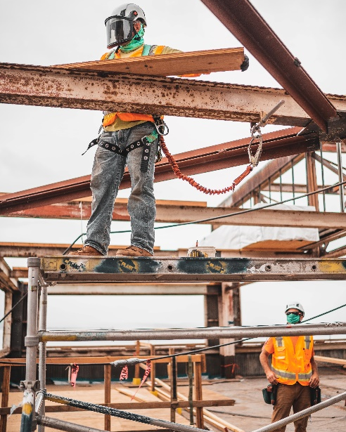
Creating a prosperous region is seen to be important/very important by 95% of residents
96% believe delivering durable infrastructure is important/very important
The below chart ranks community priorities for the CSP by level of importance based on the mean rating (1-5 scale). Detailed breakdown is shown on the following slides.
Summary of Priorities
Top 2 Box: Very important/important

Slide 34
Importance of Delivering Durable Infrastructure
Q7a. Thinking about the key direction “Deliver durable infrastructure including raw water” which includes goals such as securing our water supply and reviewing wastewater management opportunities. How important do you think this direction is for the long term future of the region?
 | Overall | Male | Female | 18-34 | 35-49 | 50-64 | 65+ | Tamworth | Other location | Ratepayer | Non-ratepayer
Mean rating | 4.77 | 4.74 | 4.80 | 4.86 | 4.76 | 4.74 | 4.73 | 4.73 | 4.81 | 4.76 | 4.82
Base | 600 | 287 | 313 | 157 | 142 | 153 | 147 | 261 | 339 | 488 | 112
‘Deliver durable infrastructure including raw water’
Scale: 1 = not at all important, 5 = very important
Base: N = 600
96% of residents believe delivering durable infrastructure is important/very important for the future of the region – 82% committing to the top box.

Slide 35
Importance of Creating a Prosperous Region
Q7c. Thinking about the key direction “Creating a prosperous region” with goals such as supporting businesses and jobs across industries, like education, aviation, food processing, agriculture and tourism. How important do you think this direction is for the long term future of the region?
 | Overall | Male | Female | 18-34 | 35-49 | 50-64 | 65+ | Tamworth | Other location | Ratepayer | Non-ratepayer
Mean rating | 4.67 | 4.64 | 4.70 | 4.74 | 4.72 | 4.60 | 4.62 | 4.62 | 4.71 | 4.67 | 4.69
Base | 600 | 287 | 313 | 157 | 142 | 153 | 147 | 261 | 339 | 488 | 112
‘Creating a prosperous region’
Scale: 1 = not at all important, 5 = very important
Base: N = 600
95% residents believe creating a prosperous region is important/very important for the future of the region, with 3 quarters stating it is very important.

Slide 36
Importance of Building Resilient Communities
Q7d. Thinking about the key direction “Building resilient communities” which focuses on improving social and community services by improving communication, enhancing education and bettering services to those in need of assistance. How important do you think this direction is for the long term future of the region?
 | Overall | Male | Female | 18-34 | 35-49 | 50-64 | 65+ | Tamworth | Other location | Ratepayer | Non-ratepayer
Mean rating | 4.46 | 4.29 | 4.61▲ | 4.60 | 4.52 | 4.27▼ | 4.45 | 4.42 | 4.48 | 4.41 | 4.66▲
Base | 600 | 287 | 313 | 157 | 142 | 153 | 147 | 261 | 339 | 488 | 112
‘Building resilient communities’
Scale: 1 = not at all important, 5 = very important
▲▼ = A significantly higher/lower level of importance (by group)
Base: N = 600
89% of residents believe building resilient communities is important/very important for the future of the region. Females and non-ratepayers rated this direction significantly higher.

Slide 37
Importance of Design with Nature
Q7f. Thinking about the key direction “Design with Nature”, which involves exploring energy efficiency, renewable energy, ensuring sustainable design, pursuing waste minimisation opportunities, and protecting local wildlife and biodiversity. How important do you think this direction is for the long term future of the region?
 | Overall | Male | Female | 18-34 | 35-49 | 50-64 | 65+ | Tamworth | Other location | Ratepayer | Non-ratepayer
Mean rating | 4.45 | 4.35 | 4.53▲ | 4.45 | 4.54 | 4.37 | 4.43 | 4.49 | 4.41 | 4.40 | 4.65▲
Base | 600 | 287 | 313 | 157 | 142 | 153 | 147 | 261 | 339 | 488 | 112
‘Design with Nature’
Scale: 1 = not at all important, 5 = very important
▲▼ = A significantly higher/lower level of importance (by group)
Base: N = 600
87% of residents believe design with nature is important/very important for the future of the region. Again, females and non-ratepayers rated this direction significantly higher.

Slide 38
Importance of Connecting the Region to its Citizens
Q7e. Thinking about the key direction “Connect our region and its citizens” which targets road safety, increasing the number of flights and locations, and improving and extending local bus and passenger rail services. How important do you think this direction is for the long term future of the region?
 | Overall | Male | Female | 18-34 | 35-49 | 50-64 | 65+ | Tamworth | Other location | Ratepayer | Non-ratepayer
Mean rating | 4.40 | 4.27 | 4.51▲ | 4.36 | 4.43 | 4.38 | 4.43 | 4.33 | 4.45 | 4.36 | 4.58▲
Base | 600 | 287 | 313 | 157 | 142 | 153 | 147 | 261 | 339 | 488 | 112
‘Connect our region and its citizens’
Scale: 1 = not at all important, 5 = very important
▲▼ = A significantly higher/lower level of importance (by group)
Base: N = 600
86% of residents believe connecting our region and its citizens is important/very important for the future of the region. Females and non-ratepayers rated this direction significantly higher.

Slide 39
Importance of Facilitating Smart Growth and Housing Choices
Q7b. Thinking about the key direction “Facilitate smart growth and housing choices” which includes components such as better managing rural-residential development, offering more diverse housing choice, and having a vibrant city centre. How important do you think this direction is for the long term future of the region?
 | Overall | Male | Female | 18-34 | 35-49 | 50-64 | 65+ | Tamworth | Other location | Ratepayer | Non-ratepayer
Mean rating | 4.32 | 4.26 | 4.38 | 4.26 | 4.43 | 4.26 | 4.34 | 4.43▲ | 4.24 | 4.30 | 4.43
Base | 600 | 287 | 313 | 157 | 142 | 153 | 147 | 261 | 339 | 488 | 112
‘Facilitate smart growth and housing choices’
Scale: 1 = not at all important, 5 = very important
▲▼ = A significantly higher/lower level of importance (by group)
Base: N = 600
85% of residents believe facilitating smart growth and housing choices is important/very important for the future of the region. This direction is rated significantly more important by those located in Tamworth.

Slide 40
Importance of Strengthening our Proud Identity
Q7h. Thinking about the key direction “Strengthen our proud identity” which focuses on celebrating and broadening Tamworth’s identity beyond country music. How important do you think this direction is for the long term future of the region?
 | Overall | Male | Female | 18-34 | 35-49 | 50-64 | 65+ | Tamworth | Other location | Ratepayer | Non-ratepayer
Mean rating | 4.14 | 4.11 | 4.17 | 4.07 | 4.19 | 4.11 | 4.20 | 4.25 | 4.06 | 4.15 | 4.10
Base | 600 | 287 | 313 | 157 | 142 | 153 | 147 | 261 | 339 | 488 | 112
‘Strengthen our proud identity’
Scale: 1 = not at all important, 5 = very important
Base: N = 600
76% rated strengthening our proud identity as important/very important for the long-term direction of the region.

Slide 41
Importance of Celebrating our Culture and Heritage
Q7g. Thinking about the key direction “Celebrate our Culture and Heritage”. This direction involves protecting the region’s heritage assets, and engaging and collaborating more effectively with our culturally diverse communities in order to respect, protect and celebrate culture across the region. How important do you think this direction is for the long term future of the region?
 | Overall | Male | Female | 18-34 | 35-49 | 50-64 | 65+ | Tamworth | Other location | Ratepayer | Non-ratepayer
Mean rating | 4.07 | 3.86 | 4.26▲ | 4.22 | 4.10 | 3.91▼ | 4.06 | 4.00 | 4.12 | 4.07 | 4.08
Base | 600 | 287 | 313 | 157 | 142 | 153 | 147 | 261 | 339 | 488 | 112
‘Celebrate our Culture and Heritage’
Scale: 1 = not at all important, 5 = very important
▲▼ = A significantly higher/lower level of importance (by group)
Base: N = 600
74% rated celebrating our culture and heritage as important/very important for the long-term direction of the region.

Slide 42
Other Considerations for the Future
Q7i. Is there anything else you think should be considered for the future of the area?
Future considerations | N = 600
Maintenance of roads and supporting infrastructure | 5%
Community consultation/engagement | 3%
Energy efficiency/alternative energy/sustainability/climate change/biodiversity | 3%
Improving/more medical and health services | 3%
Water supply/services/quality | 3%
Children/youth services/education/activities | 2%
Council (staffing/wages/transparency/accountability/mismanagement) | 2%
Economic development/attract more businesses/job opportunities | 2%
Elderly/disabled services | 2%
Events/festivals/entertainment | 2%
Management of the natural environment/trees | 2%
More safety/reducing crime/more policing | 2%
Planning for growth/infrastructure and services to match growth | 2%
Recreational opportunities e.g. pool, sporting clubs | 2%
Don't know/nothing | 64%
“Improving the rural roads especially with bitumen”
“Rural roads still have issues of speeding especially near schools”
“Council needs to consult the smaller regional areas for future ideas”
“Promotion of renewable energy sources”
“Need to address the lack of qualified medical staff and the long term retention of the medical staff need to keep staff as long as possible”
“Water needs to be taken seriously and water infrastructure needs to be managed”
“More mental health services for teenage kids”
“Services and activities for young people”
Please see Appendix A for results fewer than 2%
The majority of respondents could not provide any further considerations. Ones that were mentioned include; roads, community consultation, energy alternatives, medical services and water supply.

Slide 43
Detailed Results
1. Living in Tamworth
2. Key Performance Indicators
3. Communication
4. Community Strategic Plan
5. Future Needs Development
6. Service Area Analysis
Future Needs Development

Slide 44
Support for Increasing Rates for Specific Delivery Areas
Tamworth Regional Council’s rates are on average cheaper then Orange, Wagga Wagga and Albury as comparable councils and stated on the NSW Government’s Your Council webpage.
Q8a. How supportive are you of an increase to your rates in order to develop and invest in new facilities and to develop and maintain infrastructure?
Q8b. How supportive are you of an increase to your rates in order to deliver more community programs and community services?
Q8c. How supportive are you of an increase to your rates in order to improve and drive economic outcomes? E.g. jobs, new businesses.
Invest in new facilities and develop/maintain infrastructure
Deliver more community programs and services
Improve and drive economic outcomes
Top 3 Box: 55%
Mean: 2.62
Top 3 Box: 57%
Mean: 2.68
Top 3 Box: 63%
Mean: 2.81
Scale: 1 = not at all supportive, 5 = very supportive
Base: N = 600
Support was greater for increasing rates to improve and drive economic outcomes, with 63% stating they are at least somewhat supportive. Lower levels of support for infrastructure and community services/programs.

Slide 45
Support for Increasing Rates for Specific Delivery Areas
Tamworth Regional Council’s rates are on average cheaper then Orange, Wagga Wagga and Albury as comparable councils and stated on the NSW Government’s Your Council webpage.
Q8a. How supportive are you of an increase to your rates in order to develop and invest in new facilities and to develop and maintain infrastructure?
Q8b. How supportive are you of an increase to your rates in order to deliver more community programs and community services?
Q8c. How supportive are you of an increase to your rates in order to improve and drive economic outcomes? E.g. jobs, new businesses.
Invest in new facilities and develop/maintain infrastructure
 | Overall | Male | Female | 18-34 | 35-49 | 50-64 | 65+ | Tamworth | Other location | Ratepayer | Non-ratepayer
Mean rating | 2.62 | 2.68 | 2.58 | 2.62 | 2.68 | 2.55 | 2.66 | 2.56 | 2.67 | 2.56 | 2.92▲
Base | 600 | 287 | 313 | 157 | 142 | 153 | 147 | 261 | 339 | 488 | 112
Deliver more community programs and services
 | Overall | Male | Female | 18-34 | 35-49 | 50-64 | 65+ | Tamworth | Other location | Ratepayer | Non-ratepayer
Mean rating | 2.68 | 2.64 | 2.72 | 2.67 | 2.76 | 2.56 | 2.76 | 2.74 | 2.64 | 2.62 | 2.95
Base | 600 | 287 | 313 | 157 | 142 | 153 | 147 | 261 | 339 | 488 | 112
Improve and drive economic outcomes
 | Overall | Male | Female | 18-34 | 35-49 | 50-64 | 65+ | Tamworth | Other location | Ratepayer | Non-ratepayer
Mean rating | 2.81 | 2.82 | 2.80 | 2.86 | 2.84 | 2.66 | 2.89 | 2.86 | 2.77 | 2.74 | 3.14▲
Base | 600 | 287 | 313 | 157 | 142 | 153 | 147 | 261 | 339 | 488 | 112
Scale: 1 = not at all supportive, 5 = very supportive
▲▼ = A significantly higher/lower level of support (by group)
Base: N = 600

Slide 46
Reason for Level of Support to Increase Rates to Improve or Drive Economic Outcomes
Q8c. How supportive are you of an increase to your rates in order to improve and drive economic outcomes? E.g. jobs, new businesses
Q8d. Why do you say that?
(Column %) | Overall | Not at all supportive/Not very supportive | Somewhat supportive | Very supportive/ Supportive
Cost of living/rates too expensive/not worth it | 33% | 52%▲ | 30% | 13%▼
Mismanagement of Council funds/needs to be spent more wisely/distrust in where it will be spent | 19% | 23% | 23% | 9%▼
Will benefit the community/growth and development of the area/improve services | 12% | 8% | 9% | 21%▲
Supports employment/business/economic growth | 13% | <1%▼ | 10% | 32%▲
Supportive/necessary/needs to happen | 9% | 1%▼ | 7% | 20%▲
Businesses are not Council's/ratepayer's responsibility/source money elsewhere | 8% | 13%▲ | 9% | 3%▼
Council needs to be transparent/accountable | 7% | 8% | 8% | 4%
Equity across all communities | 4% | 7%▲ | 3% | 2%
Rate increase not urgent/necessary | 4% | 6%▲ | 4% | 1%▼
Need more information | 2% | 1% | 2% | 2%
Issues with structure of Council e.g. wages, staff, mismanagement | 2% | 4% | 1% | 2%
No impact on us/don't pay rates | 2% | 1% | 4%▲ | 1%
Lack of/needs more community consultation/engagement | 1% | 1% | 2% | 1%
Don't want to pay for services I won't use | 1% | <1% | 3% | 0%
Other comments | 1% | 1% | 3% | 0%▼
Don't know/nothing | 6% | 4%▼ | 9% | 6%
Base | 600 | 222 | 195 | 182
▲▼ = A significantly percentage (by level of support)
Those who are not at all/not very supportive of the increase in rates for economic outcomes are more likely so due to; rates being too expensive/not worth it, not Council’s responsibility, etc.
Those supportive/very supportive are so as they believe it will benefit the community, supports business/economic growth and is necessary.

Slide 47
Detailed Results
1. Living in Tamworth
2. Key Performance Indicators
3. Communication
4. Community Strategic Plan
5. Future Needs Development
6. Service Area Analysis
Service Area Analysis
This section explores Council’s performance in detail, in terms of importance and satisfaction ratings for 47 services/facilities.

Slide 48
Service Areas
A core element of this community survey was the rating of 47 facilities/services in terms of Importance and Satisfaction. Each of the 47 facilities/services were grouped into service areas as detailed below:
Social
Promoting pride in the community
Appearance of the city, towns and villages
Litter collection
Graffiti removal
Parks and playgrounds
Ovals and sportsgrounds
Community buildings/halls
Swimming pools
Art Gallery/cultural opportunities
Performing Arts/entertainment opportunities
Library services
Pet adoption/animal rehoming
Enhancing heritage buildings
Youth services
Engaging young people in planning
Support for volunteer programs
Maintaining local roads
Maintaining footpaths
Social (Cont.)
Maintaining cycleways
Traffic flow/congestion
Road safety
Availability of car parking
Overall condition of local road network
Public transport across the region
Growing airport capacity
Economic
Revitalising Tamworth and the region
Tourism/Visitor Information Centre
Infrastructure for growth
Supporting local jobs and businesses
Festival and event programs
Environment
Protecting native vegetation
Improving biodiversity
Address Climate Change
Recycling/waste minimisation
Environmental education programs
Flood protection and preparedness
Water management
Exploration of energy efficiencies
Sustainability strategy
Wastewater services
Civic
Council customer service
Council represents and advocates on behalf of the community
Council is transparent and accountable
Council provides inclusive opportunities for community to get actively-involved in decision making
Provision of Council information to the community
Long term planning for the region
Financial management
An Explanation
Importance
For the stated importance ratings, residents were asked to rate how important each of the criteria was to them, on a scale of 1 to 5.
Satisfaction
Any resident who had rated the importance of a particular criterion a 4 or 5 was then asked how satisfied they were with the performance of Council for that service or facility. There was an option for residents to answer ‘don’t know’ to satisfaction, as they may not have personally used a particular service or facility.

Slide 49
Service Area 1: Social
Detailed Overall Response for Importance
 | Not at all important | Not very important | Somewhat important | Important | Very important | Top 2 Box | Mean rating | Base
Promoting pride in the community | 2% | 5% | 25% | 33% | 34% | 68% | 3.92 | 600
Appearance of the city, towns and villages | 1% | 1% | 20% | 33% | 45% | 78% | 4.19 | 600
Litter collection | 1% | 1% | 13% | 22% | 63% | 84% | 4.43 | 600
Graffiti removal | 3% | 7% | 29% | 24% | 37% | 61% | 3.86 | 600
Parks and playgrounds | 2% | 1% | 9% | 27% | 61% | 89% | 4.45 | 600
Ovals and sportsgrounds | 2% | 4% | 16% | 29% | 49% | 79% | 4.21 | 600
Community buildings/halls | 3% | 3% | 27% | 35% | 31% | 66% | 3.88 | 600
Swimming pools | 4% | 5% | 16% | 26% | 49% | 75% | 4.11 | 600
Art Gallery/cultural opportunities | 7% | 8% | 28% | 29% | 28% | 57% | 3.64 | 600
Performing Arts/entertainment opportunities | 5% | 6% | 31% | 29% | 29% | 58% | 3.72 | 600
Library services | 4% | 6% | 22% | 25% | 43% | 68% | 3.95 | 600
Pet adoption/animal rehoming | 4% | 7% | 25% | 26% | 37% | 63% | 3.84 | 600
Enhancing heritage buildings | 2% | 7% | 24% | 29% | 38% | 67% | 3.96 | 600
Youth services | 2% | 3% | 14% | 28% | 54% | 81% | 4.28 | 600
Engaging young people in planning | 3% | 3% | 20% | 25% | 49% | 74% | 4.15 | 600
Support for volunteer programs | 1% | 2% | 17% | 27% | 52% | 79% | 4.28 | 600
Maintaining local roads | 1% | 0% | 4% | 12% | 84% | 96% | 4.78 | 600
Maintaining footpaths | 2% | 3% | 13% | 23% | 59% | 82% | 4.34 | 600
Maintaining cycleways | 8% | 4% | 23% | 25% | 41% | 65% | 3.87 | 600
Traffic flow/congestion | 1% | 3% | 13% | 27% | 56% | 82% | 4.32 | 600
Road safety | 0% | 1% | 11% | 18% | 69% | 88% | 4.55 | 600
Availability of car parking | 0% | 2% | 12% | 26% | 60% | 86% | 4.43 | 600
Overall condition of local road network | 0% | 1% | 9% | 19% | 70% | 89% | 4.57 | 600
Public transport across the region | 6% | 8% | 20% | 25% | 41% | 66% | 3.87 | 600
Growing airport capacity | 5% | 7% | 24% | 24% | 39% | 64% | 3.86 | 600
Scale: 1 = not at all important, 5 = very important

Slide 50
Service Area 1: Social
Detailed Overall Response for Satisfaction
 | Not at all satisfied | Not very satisfied | Somewhat satisfied | Satisfied | Very satisfied | Top 3 Box | Mean rating | Base
Promoting pride in the community | 4% | 10% | 28% | 42% | 16% | 86% | 3.58 | 403
Appearance of the city, towns and villages | 3% | 12% | 32% | 39% | 13% | 84% | 3.47 | 467
Litter collection | 5% | 14% | 21% | 35% | 25% | 81% | 3.61 | 505
Graffiti removal | 2% | 12% | 27% | 35% | 24% | 86% | 3.67 | 363
Parks and playgrounds | 2% | 6% | 20% | 38% | 34% | 92% | 3.96 | 531
Ovals and sportsgrounds | 1% | 6% | 15% | 37% | 42% | 93% | 4.13 | 470
Community buildings/halls | 2% | 7% | 27% | 45% | 19% | 91% | 3.70 | 396
Swimming pools | 8% | 14% | 31% | 27% | 21% | 78% | 3.38 | 442
Art Gallery/cultural opportunities | 3% | 9% | 26% | 40% | 22% | 88% | 3.69 | 337
Performing Arts/entertainment opportunities | 2% | 9% | 26% | 41% | 22% | 89% | 3.73 | 347
Library services | 0% | 2% | 14% | 38% | 45% | 98% | 4.26 | 400
Pet adoption/animal rehoming | 4% | 10% | 35% | 31% | 20% | 86% | 3.53 | 344
Enhancing heritage buildings | 2% | 15% | 29% | 37% | 17% | 83% | 3.53 | 399
Youth services | 6% | 15% | 43% | 27% | 10% | 79% | 3.19 | 465
Engaging young people in planning | 9% | 27% | 32% | 23% | 9% | 64% | 2.97 | 422
Support for volunteer programs | 2% | 12% | 33% | 36% | 17% | 87% | 3.55 | 455
Maintaining local roads | 30% | 27% | 27% | 12% | 4% | 43% | 2.34 | 573
Maintaining footpaths | 14% | 19% | 34% | 22% | 11% | 67% | 2.96 | 490
Maintaining cycleways | 11% | 15% | 30% | 29% | 14% | 74% | 3.21 | 384
Traffic flow/congestion | 9% | 18% | 34% | 30% | 9% | 72% | 3.11 | 495
Road safety | 7% | 13% | 31% | 37% | 12% | 80% | 3.35 | 525
Availability of car parking | 16% | 23% | 35% | 20% | 6% | 61% | 2.78 | 514
Overall condition of local road network | 17% | 26% | 35% | 16% | 5% | 57% | 2.67 | 535
Public transport across the region | 14% | 18% | 33% | 25% | 10% | 69% | 3.01 | 368
Growing airport capacity | 4% | 12% | 31% | 40% | 13% | 84% | 3.46 | 374
Scale: 1 = not at all satisfied, 5 = very satisfied

Slide 51
Service Area 2: Economic
Detailed Overall Response for Importance
 | Not at all important | Not very important | Somewhat important | Important | Very important | Top 2 Box | Mean rating | Base
Revitalising Tamworth and the region | 1% | 4% | 18% | 29% | 48% | 77% | 4.18 | 600
Tourism/Visitor Information Centre | 5% | 5% | 22% | 27% | 41% | 68% | 3.94 | 600
Infrastructure for growth | 1% | 3% | 14% | 24% | 58% | 82% | 4.34 | 600
Supporting local jobs and businesses | 0% | 2% | 6% | 15% | 78% | 93% | 4.69 | 600
Festival and event programs | 3% | 4% | 22% | 27% | 44% | 71% | 4.05 | 600
Scale: 1 = not at all important, 5 = very important
Detailed Overall Response for Satisfaction
 | Not at all satisfied | Not very satisfied | Somewhat satisfied | Satisfied | Very satisfied | Top 3 Box | Mean rating | Base
Revitalising Tamworth and the region | 4% | 14% | 39% | 35% | 8% | 82% | 3.30 | 457
Tourism/Visitor Information Centre | 6% | 10% | 25% | 40% | 20% | 85% | 3.59 | 394
Infrastructure for growth | 6% | 15% | 39% | 31% | 9% | 79% | 3.21 | 486
Supporting local jobs and businesses | 7% | 14% | 39% | 30% | 10% | 80% | 3.24 | 548
Festival and event programs | 7% | 10% | 29% | 37% | 17% | 82% | 3.46 | 427
Scale: 1 = not at all satisfied, 5 = very satisfied

Slide 52
Service Area 3: Environment
Detailed Overall Response for Importance
 | Not at all important | Not very important | Somewhat important | Important | Very important | Top 2 Box | Mean rating | Base
Protecting native vegetation | 2% | 4% | 19% | 22% | 52% | 74% | 4.18 | 600
Improving biodiversity | 2% | 4% | 22% | 26% | 45% | 71% | 4.07 | 600
Address Climate Change | 7% | 6% | 20% | 21% | 46% | 67% | 3.94 | 600
Recycling/waste minimisation | 0% | 1% | 8% | 23% | 67% | 90% | 4.56 | 600
Environmental education programs | 3% | 4% | 24% | 24% | 44% | 69% | 4.02 | 600
Flood protection and preparedness | 1% | 2% | 16% | 23% | 58% | 81% | 4.34 | 600
Water management | 1% | 1% | 4% | 11% | 83% | 95% | 4.76 | 600
Exploration of energy efficiencies | 1% | 4% | 18% | 23% | 53% | 77% | 4.24 | 600
Sustainability strategy | 2% | 3% | 21% | 25% | 48% | 74% | 4.14 | 600
Wastewater services | 2% | 3% | 21% | 19% | 56% | 75% | 4.24 | 600
Scale: 1 = not at all important, 5 = very important

Slide 53
Service Area 3: Environment
Detailed Overall Response for Satisfaction
 | Not at all satisfied | Not very satisfied | Somewhat satisfied | Satisfied | Very satisfied | Top 3 Box | Mean rating | Base
Protecting native vegetation | 6% | 13% | 29% | 36% | 15% | 81% | 3.42 | 434
Improving biodiversity | 6% | 15% | 37% | 35% | 8% | 79% | 3.24 | 409
Address Climate Change | 15% | 19% | 40% | 19% | 7% | 66% | 2.84 | 392
Recycling/waste minimisation | 11% | 17% | 30% | 29% | 14% | 72% | 3.17 | 539
Environmental education programs | 10% | 16% | 37% | 30% | 8% | 75% | 3.11 | 394
Flood protection and preparedness | 8% | 12% | 27% | 36% | 16% | 79% | 3.39 | 478
Water management | 13% | 25% | 32% | 21% | 9% | 61% | 2.86 | 564
Exploration of energy efficiencies | 10% | 20% | 40% | 24% | 6% | 71% | 2.98 | 433
Sustainability strategy | 6% | 16% | 42% | 31% | 5% | 78% | 3.13 | 421
Wastewater services | 5% | 11% | 28% | 41% | 15% | 84% | 3.50 | 431
Scale: 1 = not at all satisfied, 5 = very satisfied

Slide 54
Service Area 4: Civic
Detailed Overall Response for Importance
 | Not at all important | Not very important | Somewhat important | Important | Very important | Top 2 Box | Mean rating | Base
Council customer service | 0% | 4% | 18% | 24% | 54% | 78% | 4.27 | 600
Council represents and advocates on behalf of the community | 0% | 2% | 14% | 24% | 59% | 83% | 4.39 | 600
Council is transparent and accountable | 0% | 1% | 9% | 15% | 75% | 90% | 4.63 | 600
Council provides inclusive opportunities for community to get actively-involved in decision making | 1% | 3% | 15% | 23% | 58% | 81% | 4.34 | 600
Provision of Council information to the community | 1% | 3% | 12% | 26% | 58% | 84% | 4.38 | 600
Long term planning for the region | 0% | 2% | 9% | 18% | 71% | 89% | 4.58 | 600
Financial management | 0% | 3% | 10% | 15% | 73% | 87% | 4.57 | 600
Scale: 1 = not at all important, 5 = very important

Slide 55
Service Area 4: Civic
Detailed Overall Response for Satisfaction
 | Not at all satisfied | Not very satisfied | Somewhat satisfied | Satisfied | Very satisfied | Top 3 Box | Mean rating | Base
Council customer service | 9% | 19% | 21% | 31% | 19% | 72% | 3.31 | 465
Council represents and advocates on behalf of the community | 12% | 18% | 36% | 26% | 8% | 71% | 3.01 | 493
Council is transparent and accountable | 20% | 22% | 33% | 18% | 6% | 57% | 2.67 | 526
Council provides inclusive opportunities for community to get actively-involved in decision making | 17% | 24% | 33% | 19% | 7% | 59% | 2.75 | 481
Provision of Council information to the community | 12% | 19% | 38% | 23% | 9% | 69% | 2.97 | 502
Long term planning for the region | 7% | 17% | 41% | 28% | 8% | 76% | 3.13 | 524
Financial management | 13% | 17% | 41% | 22% | 8% | 70% | 2.96 | 486
Scale: 1 = not at all satisfied, 5 = very satisfied

Slide 56
Comparison to Previous Research
Service/Facility | Importance |  |  | Satisfaction
 | 2021 | 2018 | 2014 | 2021 | 2018 | 2014
Promoting pride in the community | 3.92 | 3.92 | 4.01 | 3.58 | 3.72 | 3.49
Appearance of the city, towns and villages | 4.19 | 4.27 | 4.29 | 3.47▼ | 3.70▲ | 3.51
Litter collection | 4.43 | 4.34 | 4.51 | 3.61▼ | 4.00▲ | 4.03▲
Graffiti removal | 3.86 | 3.87 | 4.20▲ | 3.67 | 3.81 | 3.64
Parks and playgrounds | 4.45 | 4.46 | 4.51 | 3.96▼ | 4.12▲ | 3.62▼
Ovals and sportsgrounds | 4.21 | 4.33 | 4.35 | 4.13 | 4.02 | 3.96
Community buildings/halls | 3.88▼ | 4.09▲ | 4.14▲ | 3.70▼ | 3.91▲ | 3.91▲
Swimming pools | 4.11 | 4.18 | 4.12 | 3.38 | 3.52 | 3.74▲
Art Gallery/cultural opportunities | 3.64 | 3.71 | 3.74 | 3.69▼ | 4.08▲ | 4.03▲
Performing Arts/entertainment opportunities | 3.72 | N/A | N/A | 3.73 | N/A | N/A
Library services | 3.95 | 4.07 | 4.13 | 4.26 | 4.34 | 4.34
Pet adoption/animal rehoming | 3.84 | N/A | N/A | 3.53 | N/A | N/A
Enhancing heritage buildings | 3.96 | 3.94 | 3.86 | 3.53▼ | 3.80▲ | 3.85▲
Youth services | 4.28 | 4.22 | 4.26 | 3.19▼ | 3.60▲ | 3.24
Engaging young people in planning | 4.15 | 4.14 | 4.09 | 2.97▼ | 3.25▲ | 2.98
Support for volunteer programs | 4.28 | 4.27 | 4.42 | 3.55▼ | 3.76▲ | 3.66
Maintaining local roads | 4.78 | 4.70 | 4.77 | 2.34▼ | 2.79▲ | 2.71▲
Maintaining footpaths | 4.34 | 4.39 | 4.45 | 2.96 | 3.11 | 2.81
Maintaining cycleways | 3.87 | 3.84 | 3.89 | 3.21 | 3.30 | 3.10
Traffic flow/congestion | 4.32 | 4.35 | 4.43 | 3.11 | 3.21 | 3.24
Road safety | 4.55 | 4.57 | 4.63 | 3.35▼ | 3.60▲ | 3.52
Availability of car parking | 4.43 | 4.43 | 4.54 | 2.78▼ | 2.97▲ | 2.86
Overall condition of local road network | 4.57 | 4.47 | 4.58 | 2.67▼ | 2.98▲ | 2.94▲
Public transport across the region | 3.87▼ | 4.05▲ | 4.00 | 3.01 | 3.13 | 3.12
Scale: 1 = not at all important/not at all satisfied, 5 = very important/very satisfied
▲▼= A significantly higher level of importance/satisfaction (by year) *Note: 2014 results are significantly tested against 2021 results

Slide 57
Comparison to Previous Research
Service/Facility | Importance |  |  | Satisfaction
 | 2021 | 2018 | 2014 | 2021 | 2018 | 2014
Growing airport capacity | 3.86▼ | 4.11▲ | N/A | 3.46▼ | 3.72▲ | N/A
Revitalising Tamworth and the region | 4.18▼ | 4.34▲ | 4.46▲ | 3.30▼ | 3.61▲ | 3.46
Tourism/Visitor Information Centre | 3.94▼ | 4.18▲ | 4.36▲ | 3.59▼ | 3.86▲ | 3.93▲
Infrastructure for growth | 4.34▼ | 4.47▲ | N/A | 3.21▼ | 3.49▲ | N/A
Supporting local jobs and businesses | 4.69 | 4.64 | 4.68 | 3.24▼ | 3.46▲ | 3.29
Festival and event programs | 4.05▼ | 4.27▲ | 4.22 | 3.46▼ | 3.88▲ | 3.76▲
Protecting native vegetation | 4.18 | 4.07 | 4.08 | 3.42 | 3.59 | 3.51
Improving biodiversity | 4.07 | 3.93 | 3.99 | 3.24▼ | 3.58▲ | 3.45▲
Address Climate Change | 3.94 | N/A | N/A | 2.84 | N/A | N/A
Recycling/waste minimisation | 4.56 | 4.51 | 4.58 | 3.17▼ | 3.73▲ | 4.00▲
Environmental education programs | 4.02 | 4.07 | 4.11 | 3.11▼ | 3.49▲ | 3.40▲
Flood protection and preparedness | 4.34 | 4.22 | 4.37 | 3.39▼ | 3.81▲ | 3.84▲
Water management | 4.76▲ | 4.62▼ | N/A | 2.86▼ | 3.35▲ | N/A
Exploration of energy efficiencies | 4.24 | 4.18 | N/A | 2.98▼ | 3.17▲ | N/A
Sustainability strategy | 4.14 | N/A | N/A | 3.13 | N/A | N/A
Wastewater services | 4.24 | 4.27 | 4.61▲ | 3.50▼ | 3.74▲ | 3.49
Council customer service | 4.27▼ | 4.45▲ | N/A | 3.31▼ | 3.72▲ | N/A
Council represents and advocates on behalf of the community | 4.39 | 4.39 | N/A | 3.01▼ | 3.37▲ | N/A
Council is transparent and accountable | 4.63 | 4.55 | N/A | 2.67▼ | 3.09▲ | N/A
Council provides inclusive opportunities for community to get actively-involved in decision making | 4.34 | 4.36 | 4.49 | 2.75▼ | 3.14▲ | 3.07▲
Provision of Council information to the community | 4.38 | 4.42 | 4.43 | 2.97▼ | 3.27▲ | 3.24▲
Long term planning for the region | 4.58 | 4.65 | 4.60 | 3.13▼ | 3.42▲ | 3.28
Financial management | 4.57 | 4.64 | 4.60 | 2.96▼ | 3.31▲ | 3.20▲
Scale: 1 = not at all important/not at all satisfied, 5 = very important/very satisfied
▲▼= A significantly higher level of importance/satisfaction (by year) *Note: 2014 results are significantly tested against 2021 results

Slide 58
Appendix A:
Additional Analyses

Slide 59
What Do You Love Most?
Q2a. What do you love most about living in the Tamworth Region?
Most loved aspect | N = 600
Rural aspect/not busy/country living | 29%
Sense of community/friendly people | 22%
Accessibility/convenient location/close to everything | 17%
Always lived here/it's home/close to family | 17%
Natural environment/scenery/open spaces | 15%
Variety and quality of services/facilities/activities | 15%
Peaceful/quiet | 9%
Employment opportunities/close to work | 7%
Climate | 4%
A good place to live/nice area | 3%
Good place to raise kids | 3%
Medical services/facilities | 3%
Variety of shopping | 3%
A safe area | 2%
Affordable living | 1%
Entertainment | 1%
Performance of Council | 1%
Progressive/forward-thinking area | 1%
Other comments | 4%
Don’t know/nothing | 5%

Slide 60
What Would You Change?
Q2b. And what would you like to change about living in the Tamworth Region?
Things to change | N = 600
Maintenance of roads and supporting infrastructure | 25%
Water supply/services/quality | 11%
More community facilities/recreation and leisure e.g. pools, water park, sporting facilities, BBQ | 10%
Safety/lowering crime | 10%
Children/youth services/education/activities | 9%
Improving/more medical and health services | 9%
Council e.g. transparency/accountability/DAs/service/financial management | 5%
Management of the natural environment/trees/mowing | 5%
Entertainment/activities/events e.g. nightlife, more dining options, music, theatre | 4%
Equity across all communities | 4%
Issues with structure of Council e.g. wages, staff, mismanagement | 4%
Overdevelopment/overpopulation/opposing specific developments/keeping the small-town feel | 4%
Footpaths/cycleways/crossings | 3%
Lower rates | 3%
Planning for growth/infrastructure and services to match growth | 3%
Public transport | 3%
Access/connectivity to other areas e.g. another access to Calala, improving the entrance to Tamworth | 2%
Community consultation/engagement | 2%
Energy efficiency/alternative energy/sustainability/climate change/biodiversity | 2%
Improve traffic flow/traffic lights/round-a-bouts | 2%
More shopping options | 2%
Parking | 2%
Waste collection/recycling | 2%
Things to change | N = 600
Affordability of housing/housing diversity e.g. more public housing | 1%
Climate | 1%
Drainage/kerb and guttering | 1%
Economic development/attract more businesses/job opportunities | 1%
Elderly/disabled services/facilities | 1%
Natural disaster management | 1%
Other comments regarding roads, traffic and parking | 1%
Promoting tourism | 1%
Road safety/education/speed regulation | 1%
Shade/coverage | 1%
Street lighting | 1%
Tamworth Airport | 1%
Town centre beautification | 1%
Arts/Cultural facilities e.g. to promote diversity | <1%
Support local businesses | <1%
Other comments | 2%
Don't know/no response/happy | 17%

Slide 61
2.2 Importance Compared to the Micromex Benchmark
Service/Facility | Tamworth Regional Council T2 box importance score | Micromex LGA Benchmark – Regional T2 box importance score | Variance
Water management | 95% | 88% | 7%
Youth services | 81% | 75% | 6%
Swimming pools | 75% | 70% | 5%
Parks and playgrounds | 89% | 84% | 5%
Supporting local jobs and businesses | 93% | 89% | 4%
Availability of car parking | 86% | 83% | 3%
Ovals and sportsgrounds | 79% | 76% | 3%
Maintaining local roads | 96% | 93% | 3%
Maintaining cycleways | 65% | 63% | 2%
Provision of Council information to the community | 84% | 83% | 1%
Support for volunteer programs | 79% | 79% | 0%
Financial management | 87% | 87% | 0%
Festival and event programs | 71% | 71% | 0%
Recycling/waste minimisation | 90% | 90% | 0%
Long term planning for the region | 89% | 89% | 0%
Council represents and advocates on behalf of the community | 83% | 83% | 0%
Maintaining footpaths | 82% | 82% | 0%
Council provides inclusive opportunities for community to get actively-involved in decision making | 81% | 82% | -1%
Flood protection and preparedness | 81% | 82% | -1%
Revitalising Tamworth and the region | 77% | 78% | -1%
Note: Benchmark differences are based on assumed variants of +/- 10%, with variants beyond +/- 10% more likely to be significant
▲/▼ = positive/negative difference equal to/greater than 10% from Benchmark.

Slide 62
2.2 Importance Compared to the Micromex Benchmark
Service/Facility | Tamworth Regional Council T2 box importance score | Micromex LGA Benchmark – Regional T2 box importance score | Variance
Community buildings/halls | 66% | 68% | -2%
Art Gallery/cultural opportunities | 57% | 59% | -2%
Appearance of the city, towns and villages | 78% | 81% | -3%
Library services | 68% | 71% | -3%
Traffic flow/congestion | 82% | 86% | -4%
Overall condition of local road network | 89% | 93% | -4%
Road safety | 88% | 92% | -4%
Public transport across the region | 66% | 71% | -5%
Promoting pride in the community | 68% | 73% | -5%
Enhancing heritage buildings | 67% | 73% | -6%
Litter collection | 84% | 90% | -6%
Protecting native vegetation | 74% | 80% | -6%
Council customer service | 78% | 84% | -6%
Wastewater services | 75% | 81% | -6%
Environmental education programs | 69% | 75% | -6%
Tourism/Visitor Information Centre | 68% | 77% | -9%
Sustainability strategy | 74% | 83% | -9%
Graffiti removal | 61% | 74% | -13%▼
Growing airport capacity (note compared to benchmark ‘airports’) | 64% | 78% | -14%▼
Note: Benchmark differences are based on assumed variants of +/- 10%, with variants beyond +/- 10% more likely to be significant
▲/▼ = positive/negative difference equal to/greater than 10% from Benchmark.

Slide 63
2.2 Satisfaction Compared to the Micromex Benchmark
Service/Facility | Tamworth Regional Council T3 box satisfaction score | Micromex LGA Benchmark – Regional T3 box satisfaction score | Variance
Revitalising Tamworth and the region | 82% | 75% | 7%
Traffic flow/congestion | 72% | 66% | 6%
Public transport across the region | 69% | 63% | 6%
Parks and playgrounds | 92% | 86% | 6%
Long term planning for the region | 76% | 71% | 5%
Supporting local jobs and businesses | 80% | 75% | 5%
Ovals and sportsgrounds | 93% | 89% | 4%
Youth services | 79% | 75% | 4%
Maintaining cycleways | 74% | 70% | 4%
Library services | 98% | 94% | 4%
Appearance of the city, towns and villages | 84% | 82% | 2%
Graffiti removal | 86% | 84% | 2%
Community buildings/halls | 91% | 89% | 2%
Flood protection and preparedness | 79% | 78% | 1%
Tourism/Visitor Information Centre | 85% | 84% | 1%
Support for volunteer programs | 87% | 86% | 1%
Promoting pride in the community | 86% | 86% | 0%
Maintaining footpaths | 67% | 67% | 0%
Financial management | 70% | 71% | -1%
Overall condition of local road network | 57% | 58% | -1%
Note: Benchmark differences are based on assumed variants of +/- 10%, with variants beyond +/- 10% more likely to be significant
▲/▼ = positive/negative difference equal to/greater than 10% from Benchmark.

Slide 64
2.2 Satisfaction Compared to the Micromex Benchmark
Service/Facility | Tamworth Regional Council T3 box satisfaction score | Micromex LGA Benchmark – Regional T3 box satisfaction score | Variance
Litter collection | 81% | 82% | -1%
Enhancing heritage buildings | 83% | 85% | -2%
Art Gallery/cultural opportunities | 88% | 91% | -3%
Growing airport capacity (note compared to benchmark ‘airports’) | 84% | 87% | -3%
Council represents and advocates on behalf of the community | 71% | 74% | -3%
Road safety | 80% | 85% | -5%
Protecting native vegetation | 81% | 86% | -5%
Sustainability strategy | 78% | 83% | -5%
Festival and event programs | 82% | 88% | -6%
Provision of Council information to the community | 69% | 76% | -7%
Swimming pools | 78% | 85% | -7%
Wastewater services | 84% | 91% | -7%
Availability of car parking | 61% | 71% | -10%▼
Council provides inclusive opportunities for community to get actively-involved in decision making | 59% | 70% | -11%▼
Environmental education programs | 75% | 86% | -11%▼
Council customer service | 72% | 84% | -12%▼
Maintaining local roads | 43% | 58% | -15%▼
Recycling/waste minimisation | 72% | 89% | -17%▼
Water management | 61% | 87% | -26%▼
Note: Benchmark differences are based on assumed variants of +/- 10%, with variants beyond +/- 10% more likely to be significant
▲/▼ = positive/negative difference equal to/greater than 10% from Benchmark.

Slide 65
Performance Gap Analysis
When analysing performance gap data, it is important to consider both stated satisfaction and the absolute size of the performance gap.
Performance Gap Ranking
Service/Facility | Importance T2 Box | Satisfaction T3 Box | Performance Gap (Importance – Satisfaction)
Maintaining local roads | 96% | 43% | 53%
Water management | 95% | 61% | 33%
Overall condition of local road network | 89% | 57% | 32%
Council is transparent and accountable | 90% | 57% | 32%
Availability of car parking | 86% | 61% | 25%
Council provides inclusive opportunities for community to get actively-involved in decision making | 81% | 59% | 22%
Recycling/waste minimisation | 90% | 72% | 18%
Financial management | 87% | 70% | 17%
Maintaining footpaths | 82% | 67% | 16%
Provision of Council information to the community | 84% | 69% | 15%
Supporting local jobs and businesses | 93% | 80% | 13%
Long term planning for the region | 89% | 76% | 13%
Council represents and advocates on behalf of the community | 83% | 71% | 13%
Traffic flow/congestion | 82% | 72% | 10%
Engaging young people in planning | 74% | 64% | 10%
Road safety | 88% | 80% | 8%
Council customer service | 78% | 72% | 7%
Exploration of energy efficiencies | 77% | 71% | 6%
Litter collection | 84% | 81% | 4%
Infrastructure for growth | 82% | 79% | 3%
Youth services | 81% | 79% | 2%
Flood protection and preparedness | 81% | 79% | 1%
Address Climate Change | 67% | 66% | 1%

Slide 66
Performance Gap Analysis
Performance Gap Ranking Continued…
Service/Facility | Importance T2 Box | Satisfaction T3 Box | Performance Gap (Importance – Satisfaction)
Public transport across the region | 66% | 69% | -3%
Parks and playgrounds | 89% | 92% | -3%
Swimming pools | 75% | 78% | -3%
Sustainability strategy | 74% | 78% | -4%
Revitalising Tamworth and the region | 77% | 82% | -6%
Environmental education programs | 69% | 75% | -6%
Appearance of the city, towns and villages | 78% | 84% | -7%
Protecting native vegetation | 74% | 81% | -7%
Support for volunteer programs | 79% | 87% | -7%
Improving biodiversity | 71% | 79% | -8%
Maintaining cycleways | 65% | 74% | -8%
Wastewater services | 75% | 84% | -9%
Festival and event programs | 71% | 82% | -11%
Ovals and sportsgrounds | 79% | 93% | -15%
Enhancing heritage buildings | 67% | 83% | -16%
Tourism/Visitor Information Centre | 68% | 85% | -17%
Promoting pride in the community | 68% | 86% | -19%
Growing airport capacity | 64% | 84% | -20%
Pet adoption/animal rehoming | 63% | 86% | -23%
Community buildings/halls | 66% | 91% | -24%
Graffiti removal | 61% | 86% | -24%
Library services | 68% | 98% | -30%
Performing Arts/entertainment opportunities | 58% | 89% | -31%
Art Gallery/cultural opportunities | 57% | 88% | -31%

Slide 67
Influence on Overall Satisfaction
The chart below summarises the influence of the 47 facilities/services on overall satisfaction with Council’s performance, based on the Regression analysis:
Chart continues on next slide…

Slide 68
Influence on Overall Satisfaction – Continued
The chart below summarises the influence of the 47 facilities/services on overall satisfaction with Council’s performance, based on the Regression analysis:

Slide 69
Other Considerations for the Future
Q7i. Is there anything else you think should be considered for the future of the area?
Future considerations | N = 600
Equity across all communities/areas | 1%
Internet/reception services | 1%
Improve traffic flow/traffic management | 1%
Lower rates | 1%
More housing diversity/public housing | 1%
Multicultural support services | 1%
Natural disaster management | 1%
Support local businesses/agriculture/farming | 1%
Public transport | 1%
Waste collection/recycling | 1%
Access to/connectivity between areas | <1%
Building approvals and regulations/DA's | <1%
Drainage/kerb and guttering | <1%
Footpaths/cycleways | <1%
Maintenance of the area | <1%
More shopping options | <1%
Parking | <1%
Promoting tourism/character of the area e.g. not just 'country music' | <1%
Other comments | 3%

Slide 70
Appendix B:
Detailed Background & Methodology

Slide 71
Background & Methodology
Sample selection and error
A total of 600 resident interviews were completed. Respondents were selected by means of a computer based random selection process using Australian marketing lists.
A sample size of 600 residents provides a maximum sampling error of plus or minus 4.0% at 95% confidence. This means that if the survey was replicated with a new universe of N=600 residents, 19 times out of 20 we would expect to see the same results, i.e. +/- 4.0%.
For the survey under discussion the greatest margin of error is 4.0%. This means, for example, that an answer such as ‘yes’ (50%) to a question could vary from 46% to 54%.
The sample was weighted by age and gender to reflect the 2016 ABS Census data for Tamworth Regional Council.
Interviewing
Interviewing was conducted in accordance with The Research Society Code of Professional Behaviour.
Prequalification
Participants in this survey were pre-qualified as being over the age of 18, and not working for, nor having an immediate family member working for, Tamworth Regional Council.
Data analysis
The data within this report was analysed using Q Professional.
Within the report, ▲▼ and blue and red font colours are used to identify statistically significant differences between groups, i.e., gender, age, ratepayer status, residential location.
Significance difference testing is a statistical test performed to evaluate the difference between two measurements. To identify the statistically significant differences between the groups of means, ‘One-Way Anova tests’ and ‘Independent Samples T-tests’ were used. ‘Z Tests’ were also used to determine statistically significant differences between column percentages.

Slide 72
Background & Methodology
Ratings questions
The Unipolar Scale of 1 to 5 was used in all rating questions, where 1 was the lowest importance or satisfaction and 5 the highest importance or satisfaction.
This scale allowed us to identify different levels of importance and satisfaction across respondents.
Top 2 (T2) Box: refers to the aggregate percentage (%) score of the top two scores for importance. (i.e. important & very important)
Note: Only respondents who rated services/facilities a 4 or 5 in importance were asked to rate their satisfaction with that service/facility.
Top 3 (T3) Box: refers to the aggregate percentage (%) score of the top three scores for satisfaction or support. (i.e. somewhat satisfied, satisfied & very satisfied)
We refer to T3 Box Satisfaction in order to express moderate to high levels of satisfaction in a non-discretionary category. We only report T2 Box Importance in order to provide differentiation and allow us to demonstrate the hierarchy of community priorities.
Percentages
All percentages are calculated to the nearest whole number and therefore the total may not exactly equal 100%.
Micromex LGA Benchmark
Micromex has developed Community Satisfaction Benchmarks using normative data from over 60 unique councils, more than 130 surveys and over 75,000 interviews since 2012.

Slide 73
Councils Used to Create the Micromex Regional Benchmark
The Regional Benchmark was composed from the Council areas listed below:
AlburyCity Council | City of Lake Macquarie | Narrandera Shire Council
Ballina Shire Council | Hawkesbury City Council | Parkes Shire Council
Bathurst Regional Council | Kempsey Shire Council | Port Macquarie-Hastings Council
Bland Shire Council | Lachlan Shire Council | Richmond Valley Council
Blue Mountains City Council | Leeton Shire Council | Singleton Shire Council
Byron Shire Council | Lismore City Council | Tamworth Regional Council
Central Coast Council | Lithgow City Council | Tenterfield Shire Council
Cessnock City Council | Maitland City Council | Tweed Shire Council
Coffs Harbour City Council | MidCoast Council | Upper Hunter Shire Council
Eurobodalla Shire Council | Mid-Western Regional Council | Wagga Wagga City Council
Forbes Shire Council | Moree Plains Shire Council | Wingecarribee Shire Council
Glen Innes Severn Shire Council | Murray River Council | Wollondilly Shire Council
Gosford (Central Coast Council) | Murrumbidgee Shire Council | Yass Valley Council
Great Lakes Council | Narrabri Shire Council

Slide 74
Appendix C:
Questionnaire

Slide 75
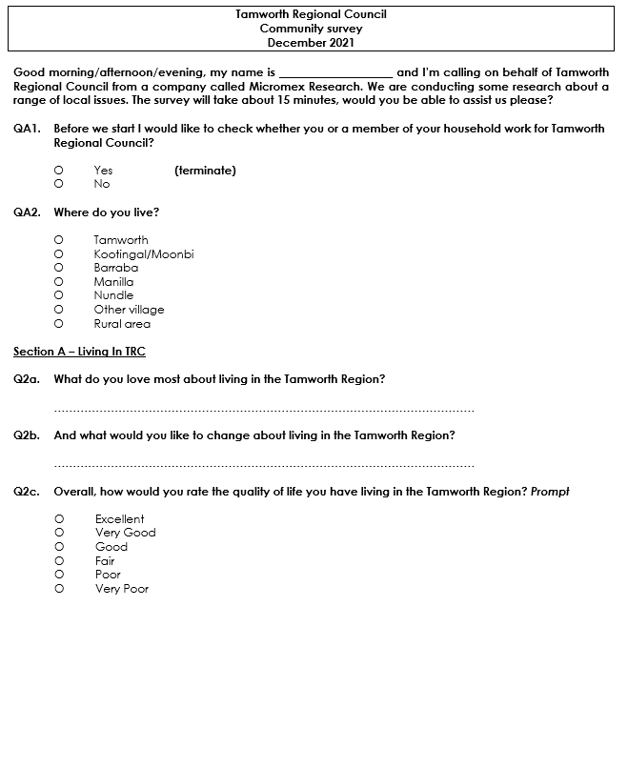
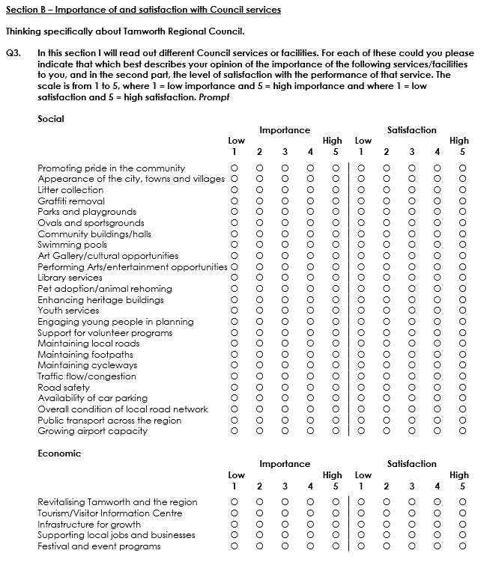

Slide 76
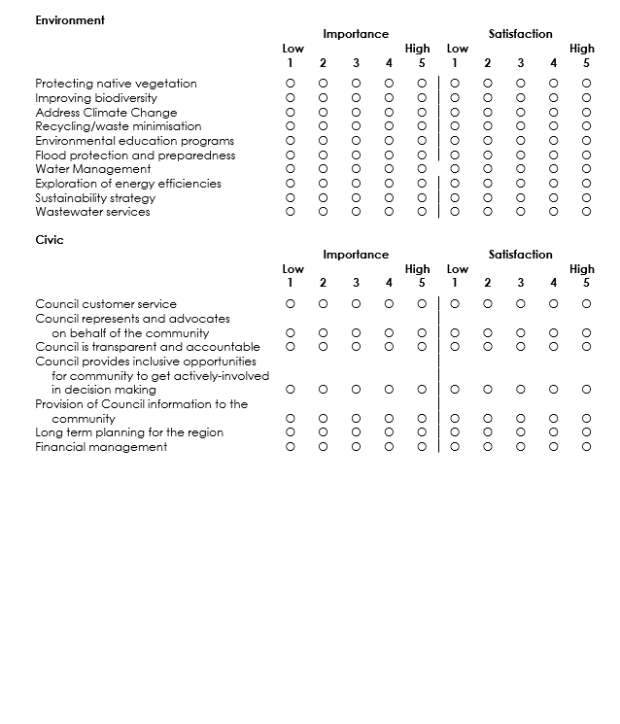
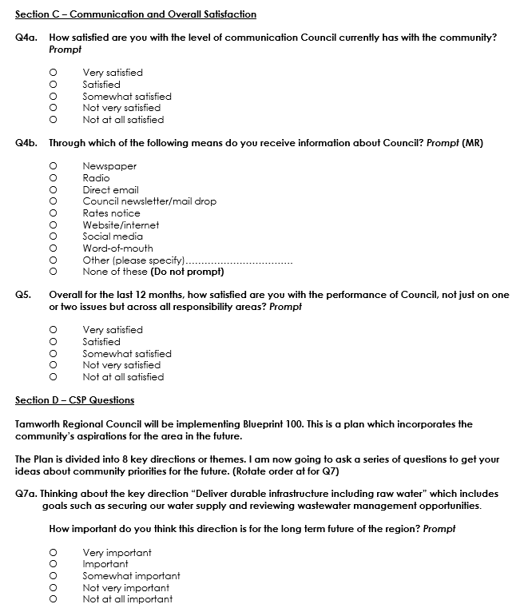

Slide 77
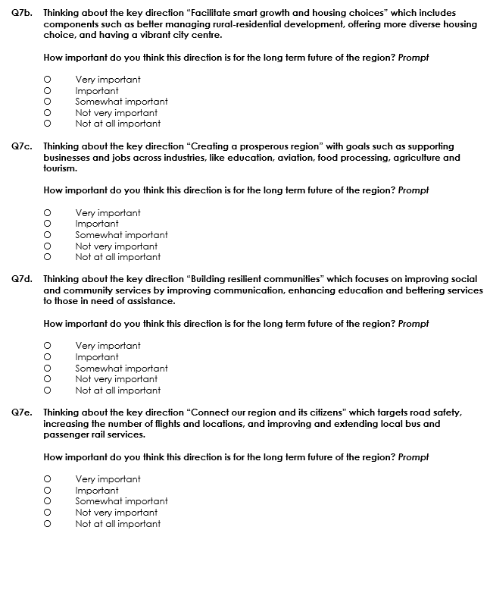
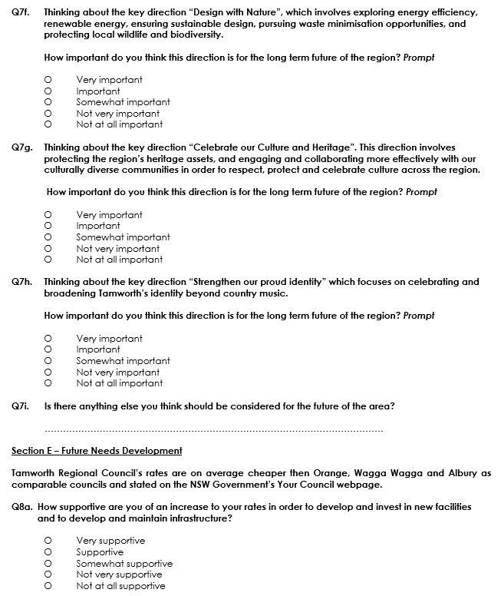

Slide 78
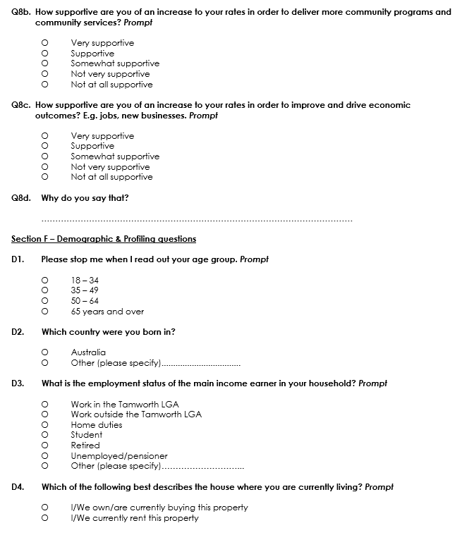
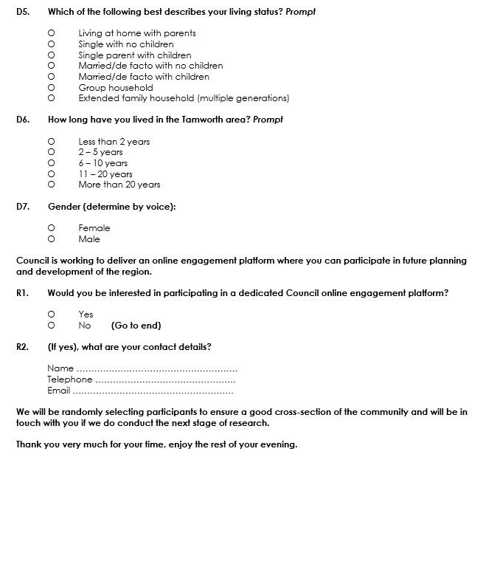
The information contained herein is believed to be reliable and accurate, however, no guarantee is given as to its accuracy and reliability, and no responsibility or liability for any information, opinions or commentary contained herein, or for any consequences of its use, will be accepted by Micromex Research, or by any person involved in the preparation of this report.

